Slide 1
Complex Care
Provider Guide
Gainwell Technologies

Slide 2
Required Forms

Slide 3
Required Forms
Attestations
A letter of Medical necessity
Complex Care Request Form
Documentation Checklist
Complete documentation must be provided to substantiate the needs of the patient
These forms can be found on LaMedicaid.com

Slide 4
Complex Care Request Form
Please select (X) all that apply:
DSW add-on request
Nursing add-on request
Equipment add-on request
SECTION 1: CLIENT INFORMATION
Name of Recipient: _______________________ Facility: _____________________________
Current Level of care (41, 42, 43, 44): __________________
Medicaid Number: ________________ Medicare Number (if applicable): ______________________
Person completing this form: __________________________ Contact number: ______________________
SECTION 2: DIRECT SUPPORT WORKER ADD-ON REQUEST
The direct support worker (DSW) add-on is only available when staffing is being provided above the minimum Title XIX staffing requirements (for example, 1:4 in the day and 1:8 at night). If the client is already receiving Pervasive Plus, the client would not qualify for the DSW add-on. This limitation includes instances where Pervasive Plus is added after the approval of a DSW add-on for complex care.
In the list below, please indicate the level of assistance that the client needs with certain activities. Full support means that the client cannot perform any aspect of the activity for themselves and needs total assistance from the DSW. Partial assistance means that the individual needs the DSW to physically provide some aspect of the activity. No or minimal assistance means that the client may need a reminder, but can otherwise physically perform most of the activity for themselves.

Slide 5
To qualify for the DSW add-on, a client must require full assistance with 4 or more activities.
Activity | Full assistance needed | Partial assistance needed | No/minimal assistance needed
Transferring (e.g., moving from a chair to bed) | q | q | q
Mobility (e.g., getting from one room to another—propelling wheelchair, walking) | q | q | q
Turning and repositioning (e.g., while in bed or wheelchair) | q | q | q
Eating | q | q | q
Bathing/showering | q | q | q
Grooming (e.g., nail care and oral hygiene) | q | q | q
Dressing (physically dressing and undressing the individual) | q | q | q
Continence and toileting | q | q | q
For clients who do not require full assistance for at least 4 activities, exceptions can be made when complicating factors are present and supported by medical documentation. Please complete the below table of complicating factors.

Slide 6
Complicating factor | Description
Documented history of falls
Skin breakdown
Sensitivity to touch or combative/agitated behavior
Dementia with confusion or disorientation
More than one person required to safely lift, transfer, reposition, bathe, dress
Contractures
Dysphagia which requires supervision

Slide 7
Documentation must be provided to substantiate the above needs, per the Documentation Checklist below.
Duration of the request:
Please indicate below the duration of the DSW add-on request. Medical documentation provided must provide evidence that the client’s condition will require the enhanced services for the duration requested. If documentation does not support that the client’s condition will require enhanced services for the requested duration, the approved duration may be reduced at the sole discretion of LDH. Requests are limited to a maximum of 1 year at a time.
Duration of DSW request: ______
SECTION 3: SKILLED NURSING ADD-ON REQUEST
Skilled nursing refers to care that can only be provided by a clinically trained and licensed nurse. The skilled nursing add-on is only available if there is a nurse on the home for at least 16 hours per day. In the list below, please indicate the client’s skilled nursing needs.
To qualify for the skilled nursing add-on, a client must have 3 or more of the below skilled nursing needs.

Slide 8
Documentation must be provided to substantiate the above needs, per the Documentation Checklist below. The presence of an “as needed” order alone is not sufficient to demonstrate need and documentation must show that the service is actually being delivered routinely. In addition, nursing documentation must show that the services indicated above are being provided by a nurse.
:
To qualify for the skilled nursing add-on, a client must have 3 or more of the below skilled nursing needs.
Skilled nursing need | Check all that apply
Nasopharyngeal, tracheal, tracheostomy, or oral suctioning | q
Enteral feeding (tube feeding) with complications such as reflux, combative/agitated behavior, or contractures | q
Urinary or vesicostomy catheterization and care | q
Colostomy care | q
Nebulization treatments and nebulizer care | q
Ventilator or positive airway pressure device care | q
Diabetes care with injectable medications | q
Administration of intravenous, intramuscular, or subcutaneous injections other than diabetes medications | q
Wound care involving prescription medications and dressings with aseptic technique | q
Administration of five (5) or more different medications per day (can be a combination of oral and topical) | q
Three (3) or more skilled nursing assessments per day (e.g., neurological checks, glucose measurements) | q

Slide 9
Duration of the request:
Please indicate below the duration of the skilled nursing add-on request. Medical documentation provided must provide evidence that the client’s condition will require the enhanced services for the duration requested. If documentation does not support that the client’s condition will require enhanced services for the requested duration, the approved duration may be reduced at the sole discretion of LDH. Requests are limited to a maximum of 1 year at a time.
Duration of skilled nursing request: ___________
SECTION 4: EQUIPMENT ADD-ON REQUEST
The equipment add-on is available when clients need certain types of supplies. This add-on is only applicable to clients with Medicaid only and no other insurance. For example, clients with both Medicaid and Medicare are not eligible.
Equipment | Check all that apply
Enteral nutrition (tube feeding) supplies, does not include supplemental feeding | q
Ostomy supplies | q
Tracheostomy supplies | q
Documentation must be provided to substantiate the above needs, per the Documentation Checklist below
Duration of the request:
Please indicate below the duration of the equipment add-on request. Medical documentation provided must provide evidence that the client’s condition will require the enhanced services for the duration requested. If documentation does not support that the client’s condition will require enhanced services for the requested duration, the approved duration may be reduced at the sole discretion of LDH. Requests are limited to a maximum of 1 year at a time.
Duration of equipment request: ___________

Slide 10
SECTION 5: ATTESTATIONS
Two attestations must be completed for this form. The first attestation must be completed by a licensed clinician operating within their scope of practice who has reviewed this form. If only the DSW add-on, the equipment add-on, or both are requested, the attestation may be signed by a physician, advance practice registered nurse, physician assistant, or an occupational, physical, or speech therapist. If the skilled nursing add-on is requested alone or in combination with any other add-on, the attestation must be signed by a physician, advance practice registered nurse, or a physician assistant.
I attest that this form is a true, accurate, and complete description of this client’s needs and the rationale for the DSW add-on, the skilled nursing add-on, the equipment add-on, or a combination of the three.
Name: __________________________ Date: ______________
Signature: ________________________
Profession: _______________________ License number: _________________
The second attestation must be completed by the executive director of the facility:
I understand and will adhere to the rules and regulations for the add-on(s) requested in this form. I attest that the increased payments made will be used for the direct benefit of the individual and to meet the needs described in this form. I am aware of and agree that funds received as a result of attestation are subject to the Direct Care Floor process as described in the Louisiana Register, Title 50 Public Health Medical Assistance, Part VII Long Term Care, Subpart 3. Intermediate Care Facilities for Persons with Intellectual Disabilities, Chapter 329 Reimbursement Methodology, Subchapter A. Non State Facilities, ss 32901 Cost Reports, (C) Direct Care Floor.
I attest that all staff will operate within the scope of practice of their license and supervisors of unlicensed personnel will ensure that all persons operating under their license are properly trained and demonstrate competency in the skills needed.
I acknowledge that we will abide by all LDH rules and policies including but not limited to, any additional requirements in the annual survey, fiscal analysis and reporting, etc.
Executive Director Name: __________________________ Date: ______________
Executive Director Signature: ________________________

Slide 11
SECTION 6: DOCUMENTATION CHECKLIST
Requests for the DSW add-on, the skilled nursing add-on, the equipment add-on, or a combination of the three must include all of the following documentation. Request forms submitted without the required documentation will be returned without review by LDH.
1. A letter of medical necessity is required for all add-on requests. It must describe the client’s needs as listed in this request form and be signed by a licensed clinician. If only the DSW add-on, the equipment add-on, or both are requested, the letter of medical necessity may be signed by a physician, advance practice registered nurse, physician assistant, or an occupational, physical, or speech therapist. If the skilled nursing add-on is requested alone or in combination with any other add-on, the letter of medical necessity must be signed by a physician, advance practice registered nurse, or a physician assistant.
DSW add-on:
Note: If the client is already receiving Pervasive Plus, the client would not qualify for the DSW add-on. This limitation includes instances where Pervasive Plus is added after the approval of a DSW add-on for complex care.
2. DSW staffing schedule for the previous 2-week period showing staffing above the minimum
Functional assessment by a licensed physical or occupational therapist, within the last 90 days, with specific instructions for DSWs
3. Assessment by a licensed speech language pathologist, within the last 90 days, for individuals with swallowing disorders needing mealtime guidelines or communication instructions, with specific instructions for DSWs
Skilled nursing add-on:
4. Nursing staffing schedule for the previous two-week period
5. Nursing documentation for the prior 2 weeks demonstrating the skilled nursing needs and activities performed by a nurse
Equipment add-on:
6. Documentation of the client’s equipment needs, which may be included in the letter of medical necessity, functional assessment (if applicable), or nursing documentation (if applicable)

Slide 12
What is Electronic Prior Authorization
(e-PA)
All requests will be submitted through E-PA
The Electronic Prior Authorization (e-PA) Web Application provides a secure, web-based tool for providers to submit a prior authorization (PA) request and to view the status of a current or previously submitted requests. This tool is intended to eliminate the need for hard-copy paper PA requests as well as provide a more efficient and timely method of receiving PA request results.

Slide 13
The steps below provide a basic high-level overview of what is required to submit a PA request using the e-PA application. Detailed step-by-step instructions are listed in Section 3.0 of this document.
1. Enter the secured provider area of the LAMedicaid.com website
2. Select the Electronic Prior Authorization application link
3. Select PA Request
4. Enter the recipient’s 13-digit Medicaid ID number and date of birth
5. Select the Submit button
Complete the PA Request Entry page & select the Submit button
UP-LOAD the Documents
9. Once the documentation has been up-loaded to e-PA system, it will be cross- referenced back to the original electronic request and assigned a 9-digit PA number and moved to an e-PA queue where the review process will begin.

Slide 14
Accessing the EPA Application

Slide 15
2.0 ACCESSING THE APPLICATION
This section provides information on how to access the Electronic Prior Authorization (e-PA) application via Provider Login. It includes instructions on how to establish an online account with Louisiana Medicaid and complete the Login ID and password process. The Louisiana Department of Health (LDH) determines who is an authorized user defining all user access capabilities. Directions for establishing a valid online provider account are available on the Louisiana Medicaid website at www.lamedicaid.com under the Website Enrollment link located under Provider Tools on the left side of the main menu.

Slide 16
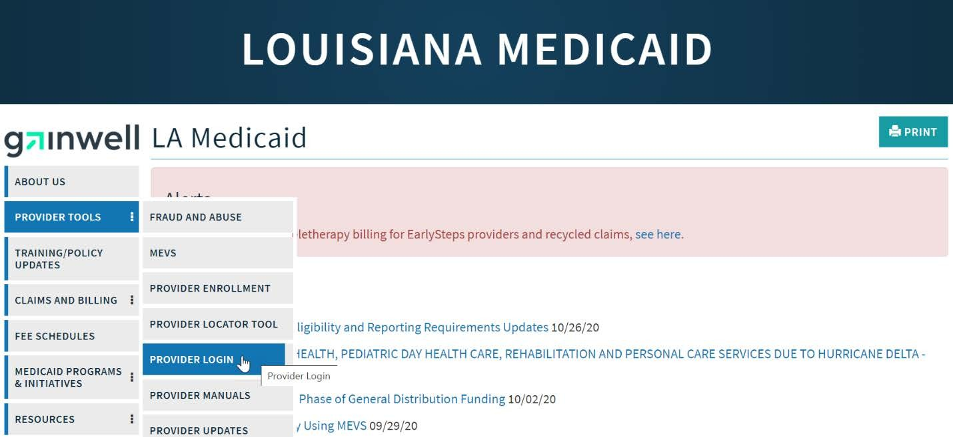
Providers who are experiencing difficulty in establishing an account or with the application may contact the Gainwell Technologies Technical Support Desk at 1-877-598-8753, Monday – Friday 8:00 a.m. – 5:00 p.m. CT or request support by e-mailing lasupport@dxc.com.
In order to access the Electronic Prior Authorization application, or any other secure application, users must navigate through the Provider Login section of the Louisiana Medicaid web site.
Open a web browser and enter the URL for Louisiana Medicaid at www.lamedicaid.com. Click the Provider Login
link under Provider Tools on the left side of the main menu to continue.

Slide 17
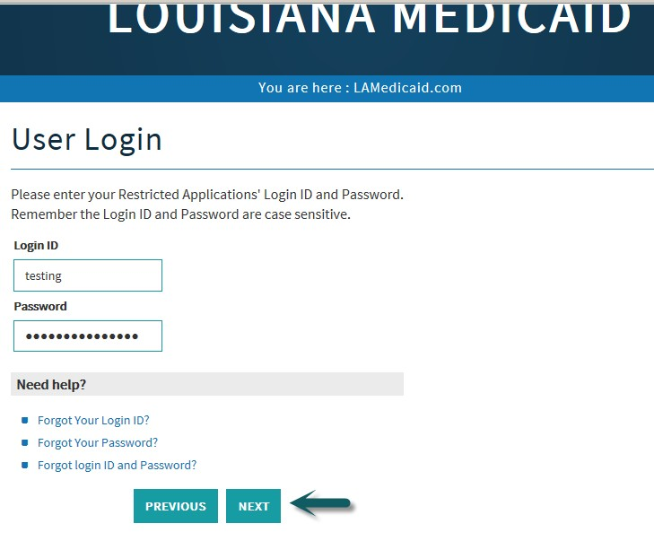
At the User Login screen, users must input their Login ID and Password before clicking the
Next button to continue.
Note: Login ID and Password are case sensitive

Slide 18
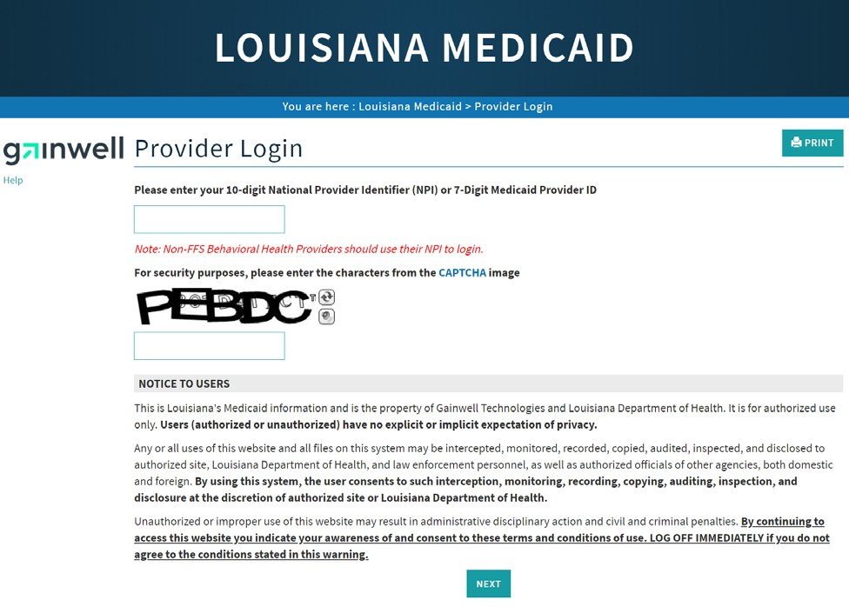
At the Provider Login screen, users may read through the Notice to Users. In order to continue, users must enter their 10-digit
National Provider Identifier (NPI) or 7-Digit Medicaid Provider ID in the field provided and enter the characters from the CAPTCHA
image before clicking the Next button.

Slide 19
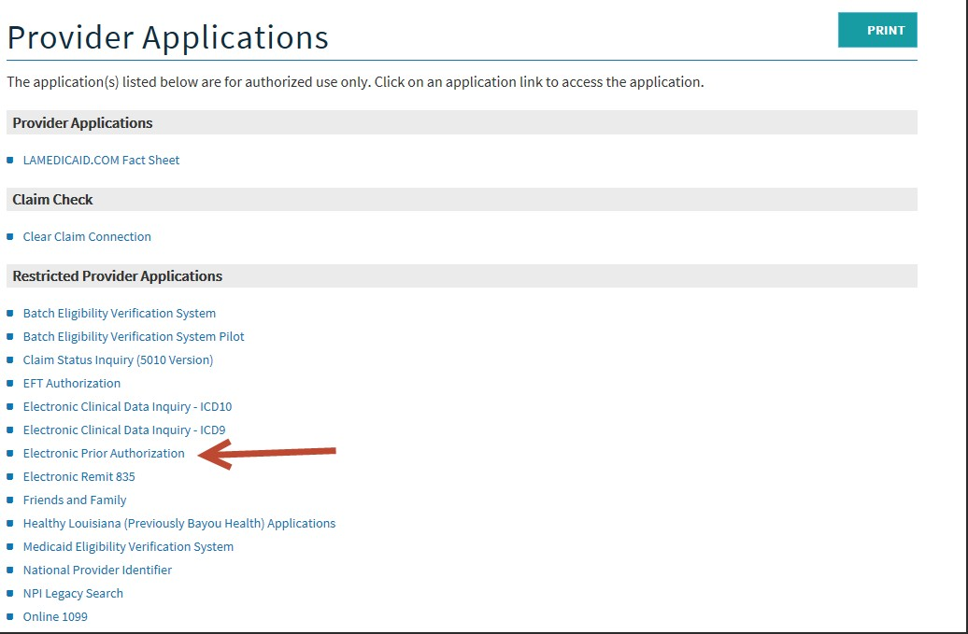
Users will be directed to the Provider Applications page where they can access their authorized applications.
Click the Electronic Prior Authorization link to continue.
Note: The list of applications shown here is comprehensive; therefore, you may not see as many
options on the Provider Applications page.

Slide 20
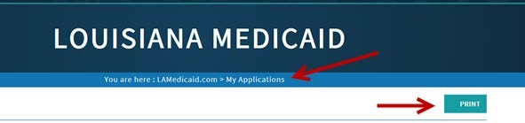
3.0 USING THE APPLICATION
New Functionality
Please note that with the new redesign, backwards navigation throughout any application can be done by
clicking on the breadcrumb trail located on the blue ribbon at the top of any screen.
Users also have access to a Print screen button located on the top right-hand corner of every screen.

Slide 21
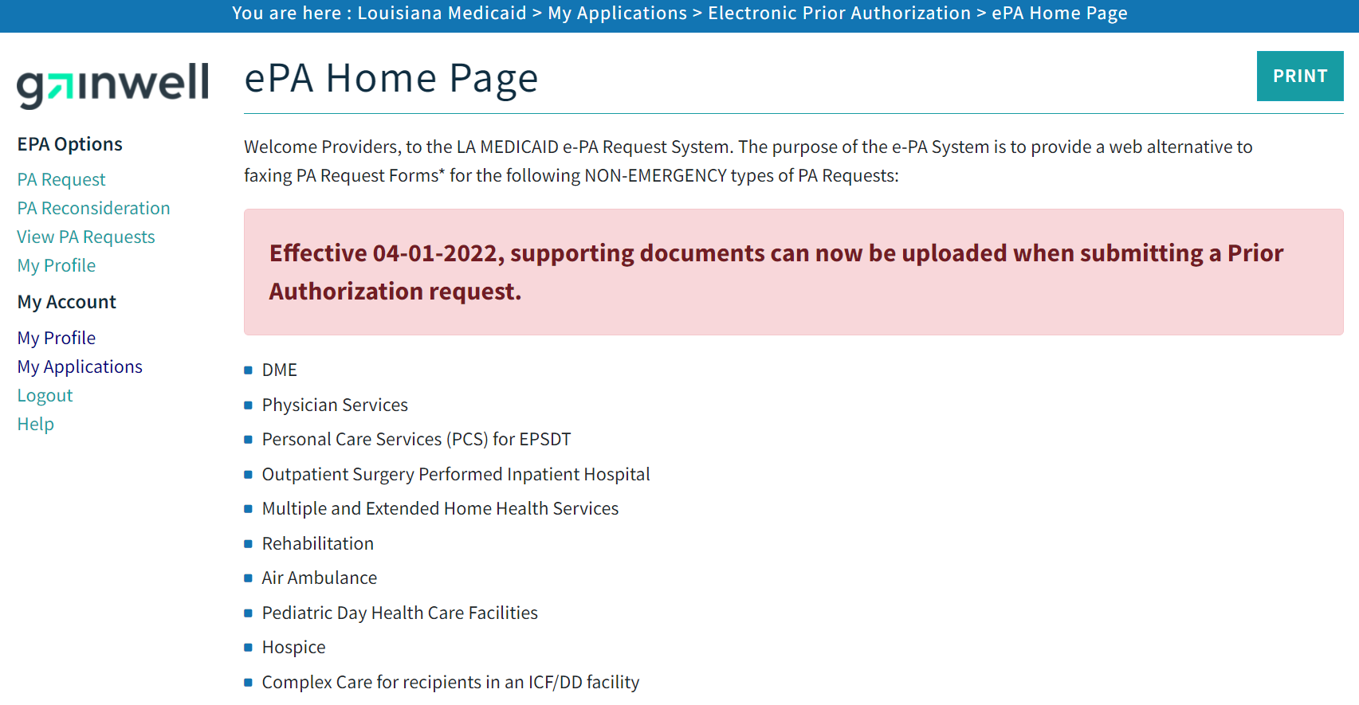
The Louisiana Medicaid Prior Authorization Request Home Page is displayed.
Select the PA Request link located in the upper left side of the main application page.

Slide 22
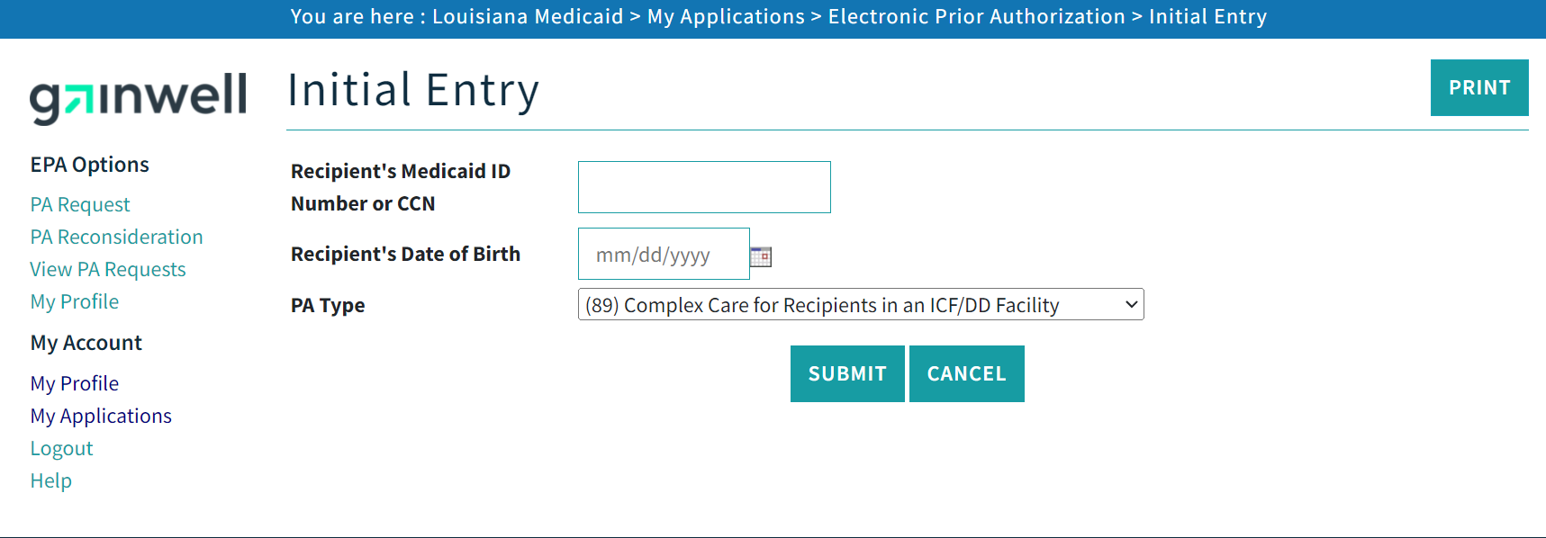
3.1 Recipient & PA Type Entry
The Recipient & PA Type Entry page will be displayed.
On the Recipient & PA Type Entry page, enter the Recipient’s Medicaid ID number or CCN and the Recipient’s Date of Birth in the appropriate boxes. In the PA Type drop-down list your PA Type (89) will be displayed. Select the Submit button to continue the process.
If you wish to discontinue the request, click the Cancel button and you will be returned to the e-PA home page.

Slide 23
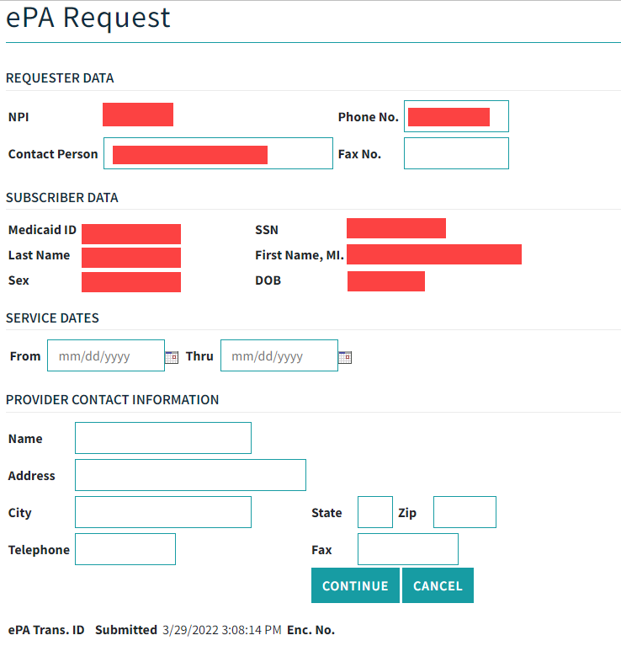
3.2 PA Request Entry
On the PA Request Entry page all of Provider and Recipient’s information will be automatically populated. ( All highlighted fields)
Provider will have to Fill out the From and Thru dates of service.
There is a place for Provider contact. This field is optional
Once you have completed the required fields, select the Continue button at the bottom of the page.
An upload page will be displayed.

Slide 24
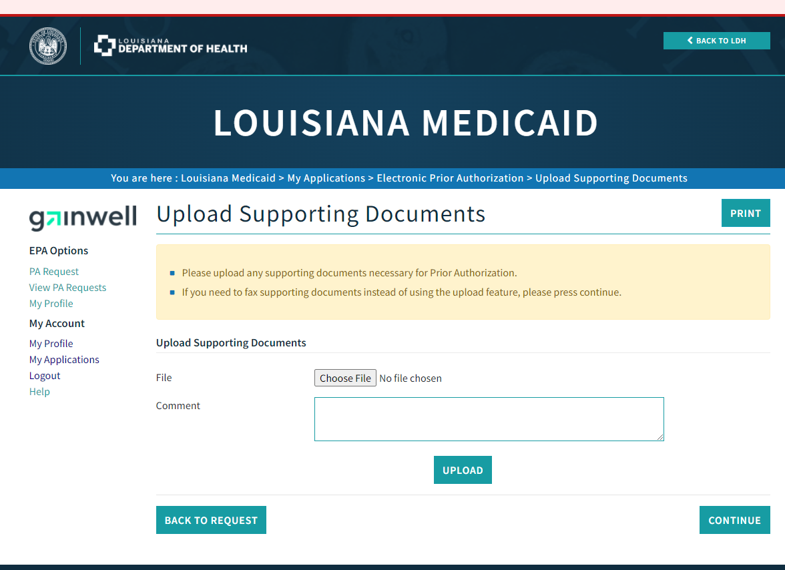
EPA-UPLOAD PAGE
Follow the instructions, Upload documents and hit continue. This will lead you to the Confirmation Page

Slide 25
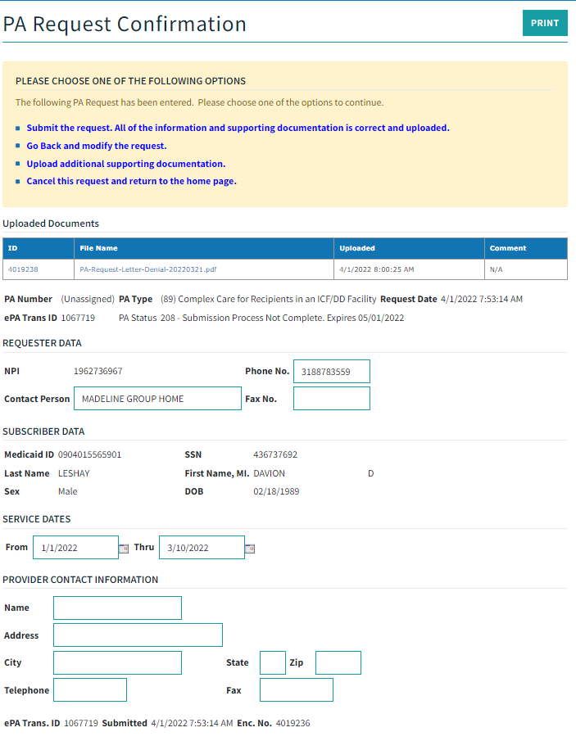

Slide 26
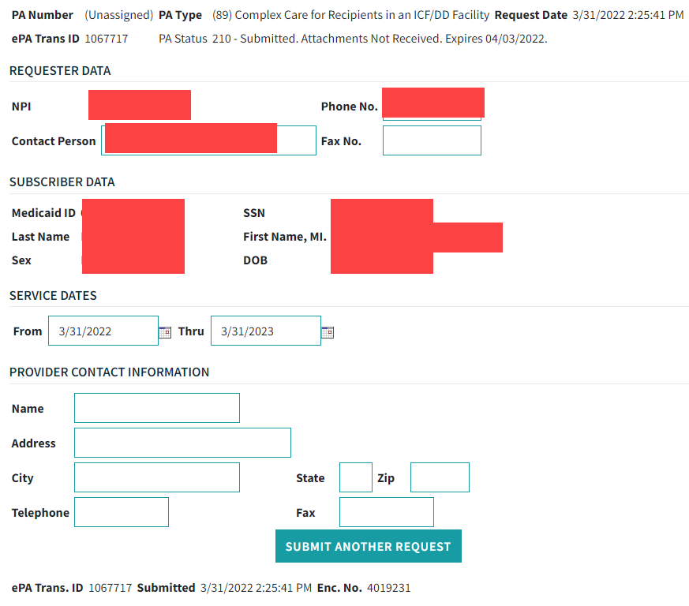
PA Request Confirmation Page
Once you “submit the request, all the information and supporting documentation is correct and uploaded”, this page will appear.
This will allow you to “submit another request” See at the bottom.

Slide 27
New Confirmation Process
The Electronic Prior Authorization (e-PA) application has been enhanced with a new confirmation process to facilitate editing requests before submitting for review. Once a user submits a request, a confirmation message will be displayed that will allow the following actions:
Submit (Complete) the request. This will finalize the request and send it for review.
Go back and modify the request. This will allow users to correct any information on the request before submitting the request.
Cancel the request. This will finalize the request and no further action will be taken.
The following policies have been enacted:
Users can modify a request as many times as they need to but will only have 30 days to submit or cancel a request. After 30 days, the request will expire
Once submitted, users will have 3 days to send attachments. If attachments have not been received within 3 days, the request will be cancelled and a new request will be required.
If attachments are received after 3 days, the request will be cancelled by Gainwell Technologies and a new request will be required.
A Prior Authorization number will not be assigned until attachments have been received. The attachments must be received within 3 days of the submission of the request.
Additional statuses have been added to facilitate the confirmation process.
208 - Submission Process Not Complete. Expires <30 days from initial request date>.
209 - Cancelled by User. A New Request is Required.
210 - Submitted. Attachments Not Received. Expires <3 days from submission date>.
211 - Cancelled by Gainwell Technologies. Attachments Not Received Within 72 Hours. A New Request is Required.
212 - Attachments Received.
213 - Cancelled by Gainwell Technologies. Attachments Received After 72 hours. A New Request is Required.
214 - Request Has Expired. A New Request is Required.

Slide 28
Viewing Prior Authorization Request

Slide 29
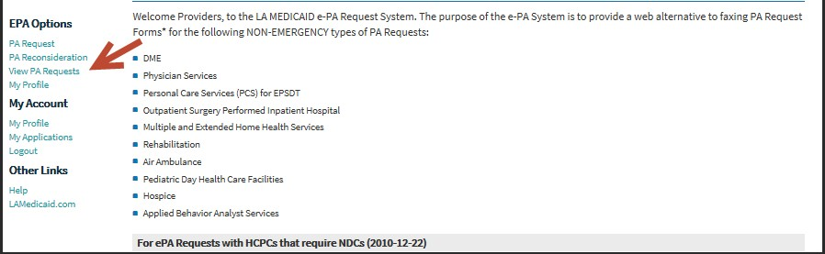
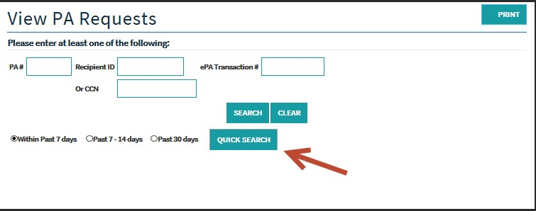
3.5 A Request Search
The search screen allows a provider to search for a Prior Authorization Request. Once a provider locates a PA,
they can review the
PA information using the PA Request Review screen.
View PA Requests link on the left side of the Home Page.

Slide 30
Medical Consultant Reviews the Documents and Decision is made
Request Approved or Denied
Gainwell Technologies will generate a Report each night with the results of the requests that were resolved that day
LDH will access the report with full explanation(s) regarding the decision
LDH will inform Providers regarding the final decision based on the explanation(s) from Gainwell in the reports.
If the request is denied. You will have to submit a new PA request with required documentation

